Slide 1
Muhammad Hamza
Final Project DengAI: Predicting Disease Spread
Roll no : 18101136 Course : Tools and Techniques for Data Science

Slide 2
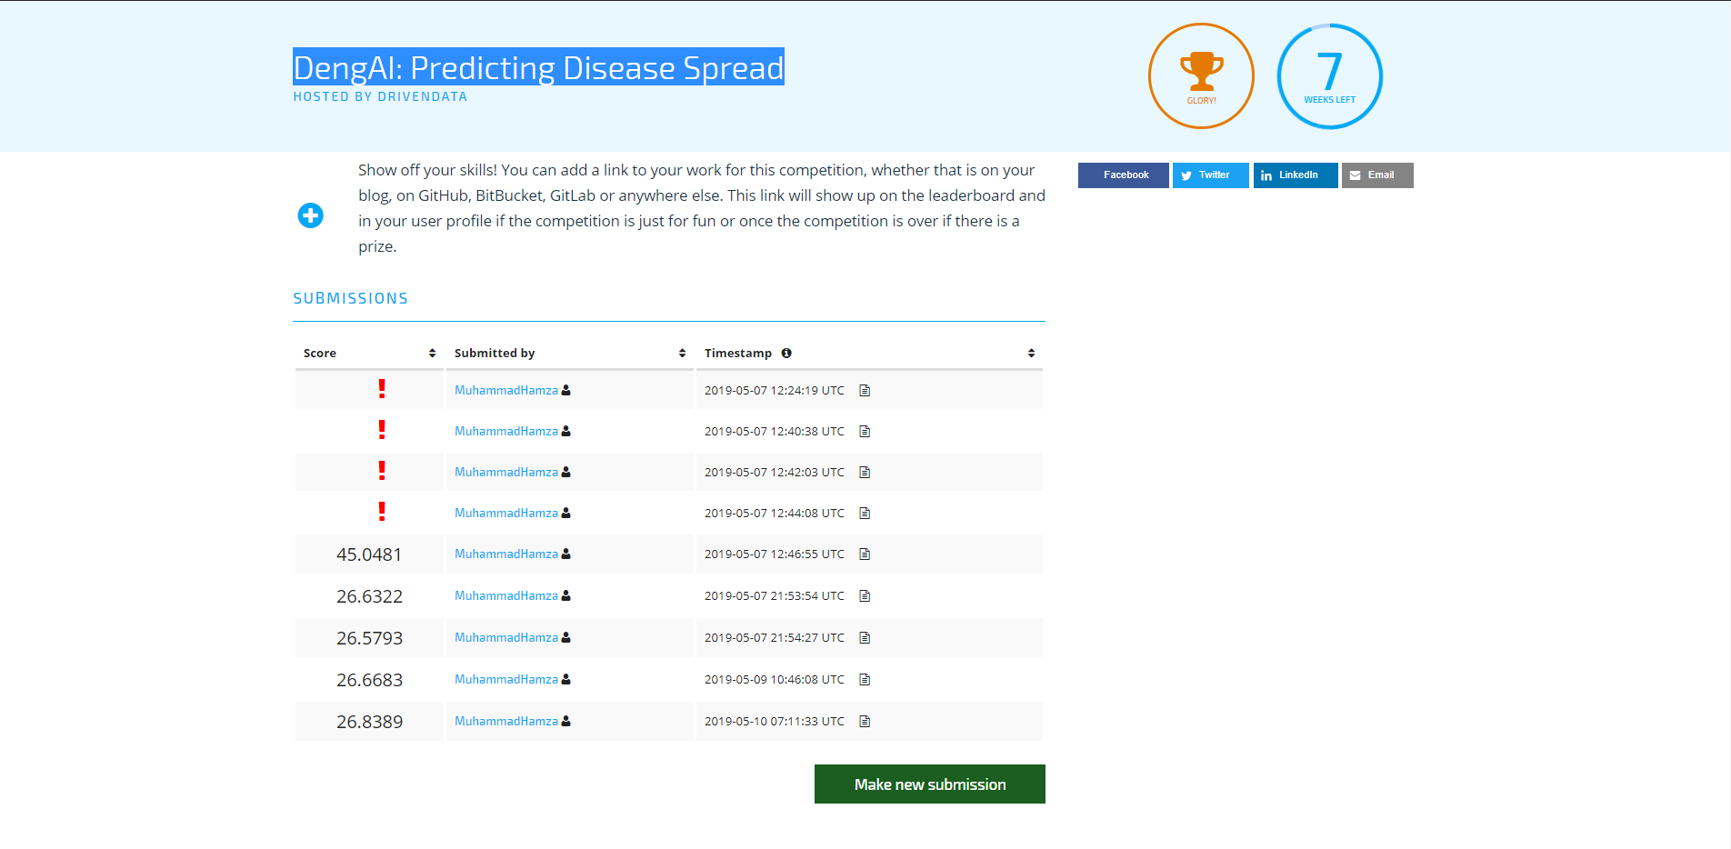
DengAI: Predicting Disease Spread
GitHub : https://github.com/MuhammadHamzaRajput/FinalProjectTandT

